Slide 1
THIRUVALLUVAR COLLEGE
Papanasam
Department of Mathematics

Slide 2
TOPIC
Tracing the growth of the global community : A Population Forecasting Analysis
Team Members:
M. Elakkiya
P. Vidya
J. Thanga Lakshmi
M. Roobini

Slide 3
A Population Forecasting Analysis
Introduction
Overview
Population forecasting is a method to predict or forecast the future population of an area. Usually, the population at the design period of water supply systems is predicted to find the water demand at that time, as the systems are required to fulfill their purposes till the end of the design period.
It also gives a picture of what the future size and structure of the population by sex and age might look like.

Slide 4
Purpose
Population analysis is needed to identify problems and community needs, establish goals and objectives, assess alternative courses of action, allocate resources for plan implementation, and evaluate the ability of the plan to achieve goals and objectives.

Slide 5
Problems Definitions and Design thinking.
What are the problems caused due to overpopulation?
What are problems caused due to unemployment?

Slide 6
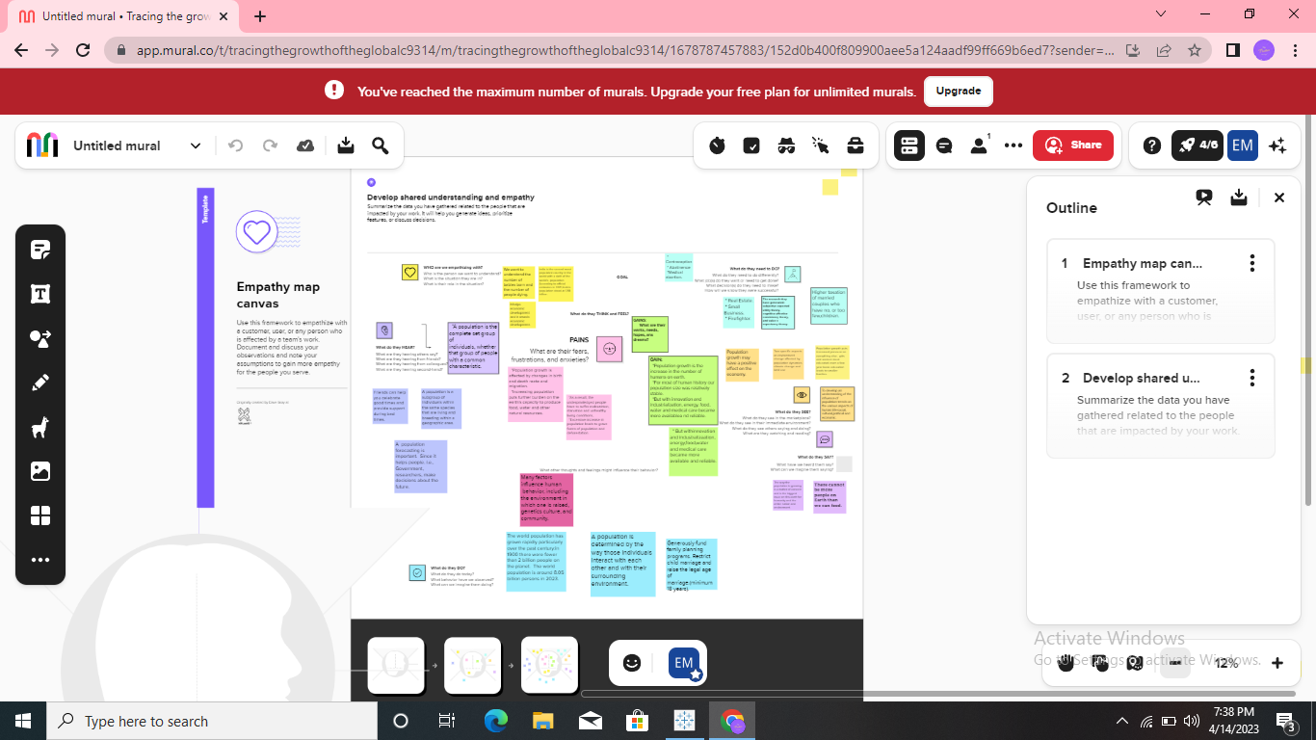
Empathy Map

Slide 7
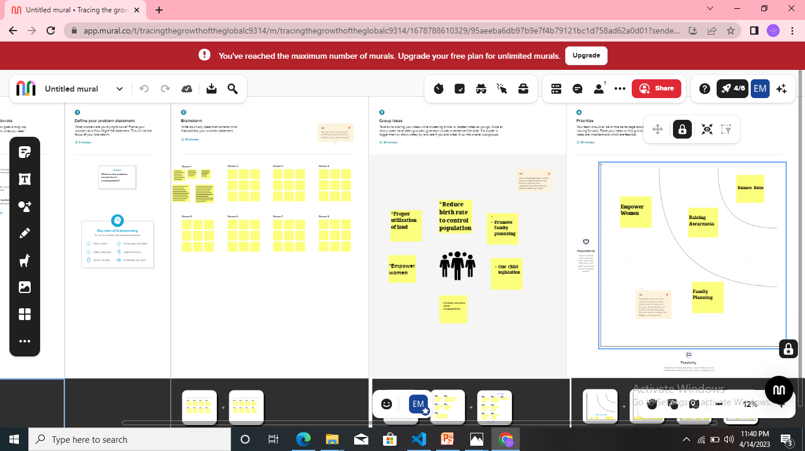
Ideation and brainstorming Map

Slide 8
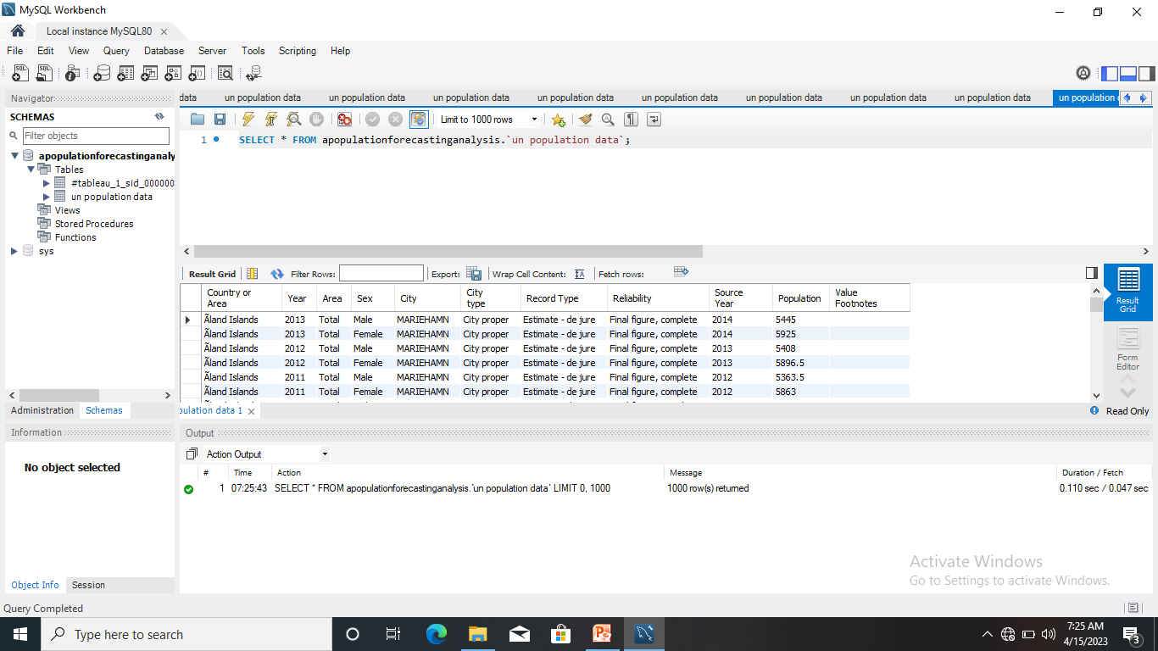
My SQL

Slide 9
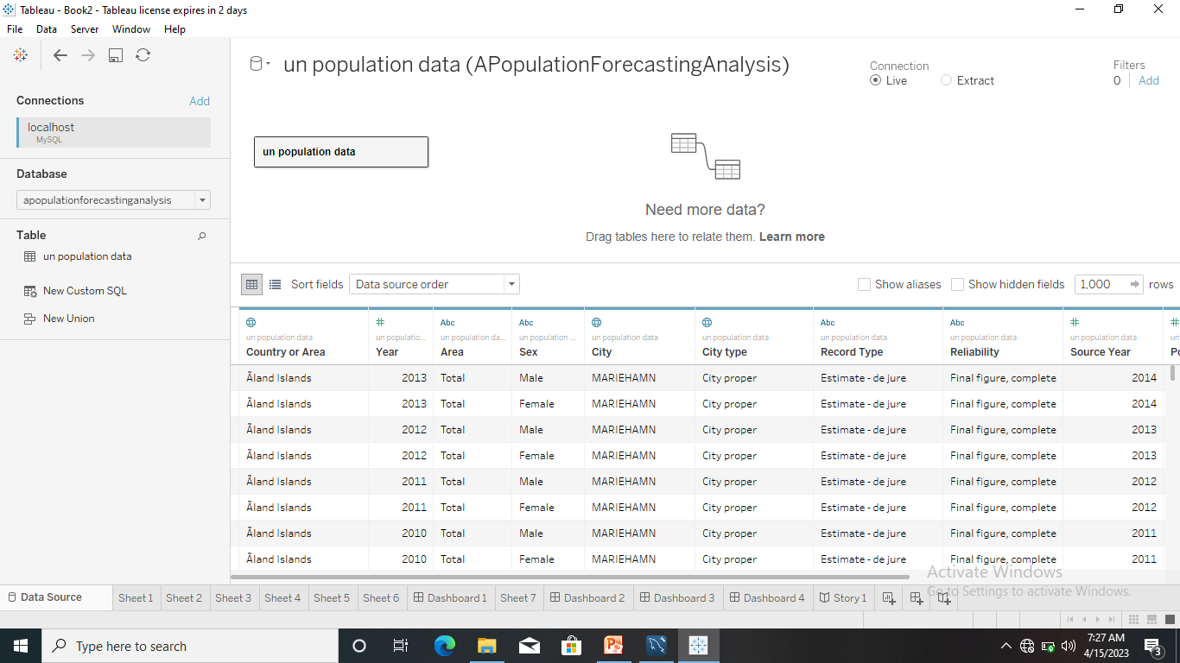
Result Tableau output

Slide 10
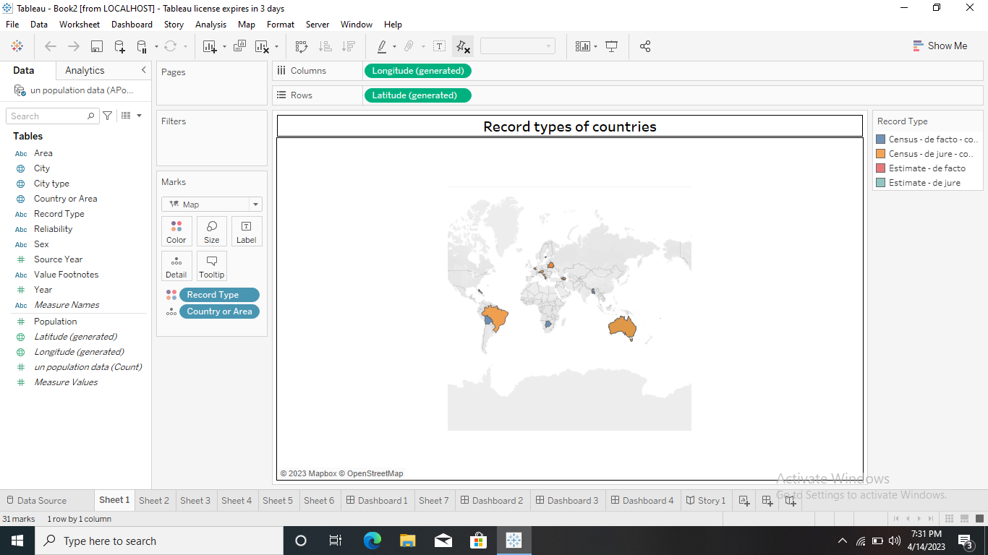
Sheets 1

Slide 11
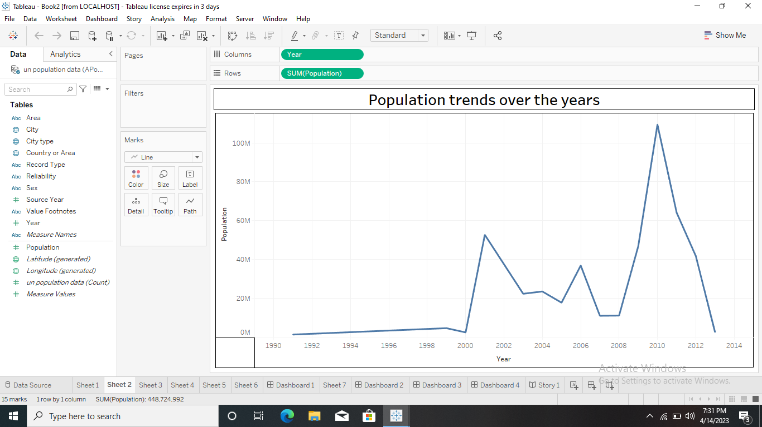
Sheet 2

Slide 12
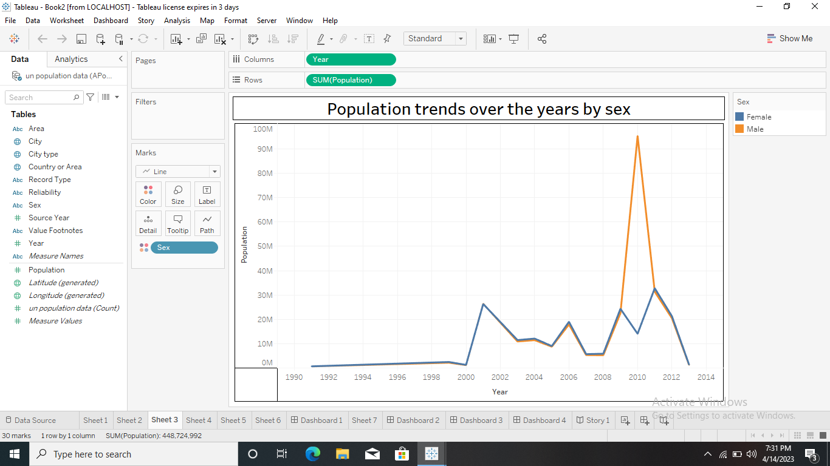
Sheet 3

Slide 13
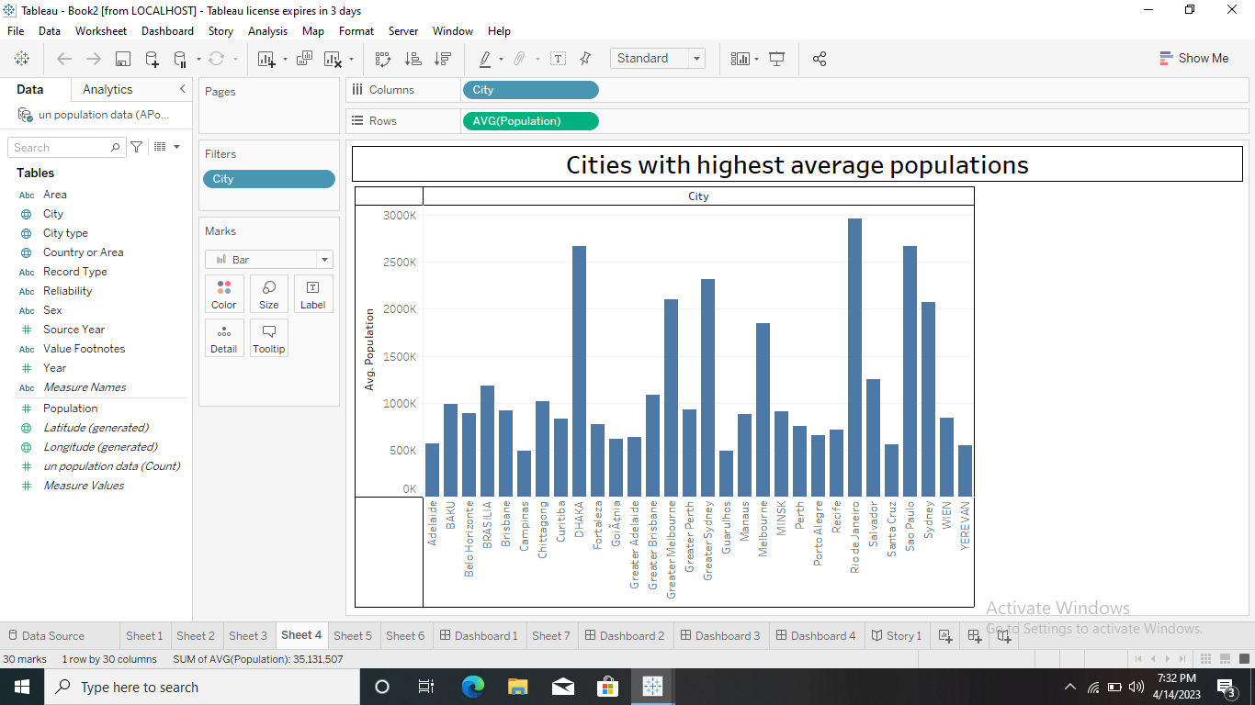
Sheet 4

Slide 14
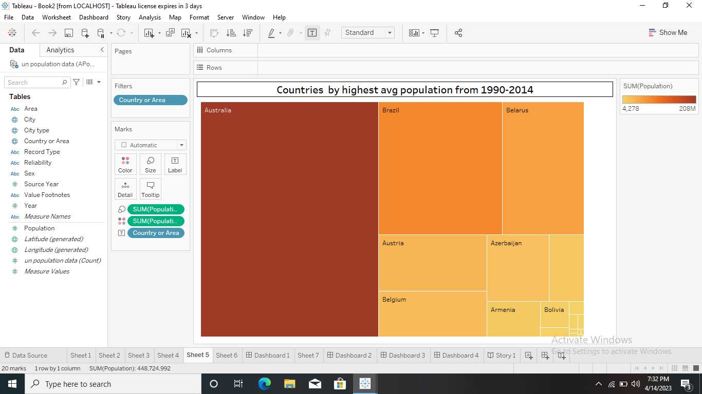
Sheet 5

Slide 15
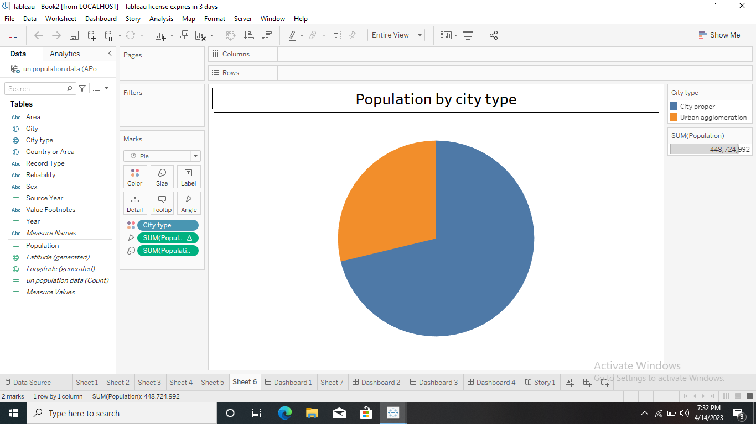
Sheet 6

Slide 16
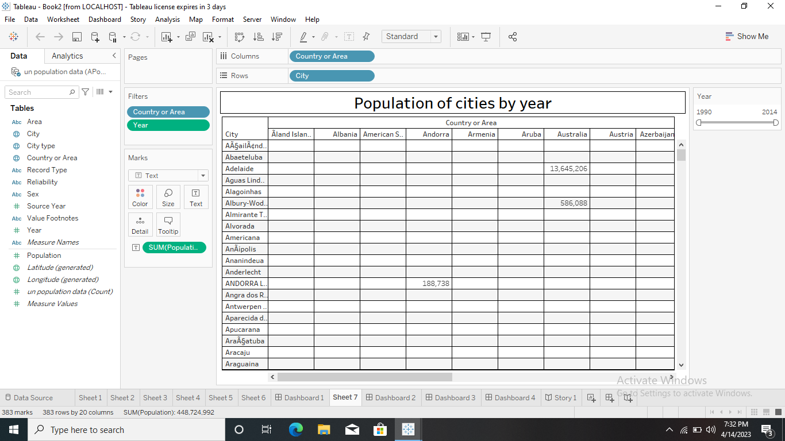
Sheet 7

Slide 17
Advantages and disadvantages
Advantages of population:
Greater economic growth:
Human resources will increase
Increased productivity through specialization
Demand has led to more jobs
Higher population density efficiency

Slide 18
Greater economic growth
Population growth will lead to economic expansion since more people can produce more goods. More money will be available in tax revenue to fund public services like environmental and health care programs. The obvious conclusions is that GDP per capita is the essential element rather than GDP as a whole.

Slide 19
Demand has led to more jobs
More people means a greater demand for products and services so more jobs are needed for production. Workers are needed at every level from the production of basic materials through multiple stages to final distribution during consumption.

Slide 20
Disadvantages of Population
Increasing Resources Demand
Shortage of food due to population expansion
Generating Non-biodegradable waste.
Increasing population
Threat to Natural Habitat

Slide 21
Increasing resources demand
Demand for resources rises as the population grows resources, however, are in infinite quantity thus, this is a an issue because if a large number of people utilize them, they will run out and become scarce, resulting in poverty.
Increasing Pollution
More people will provide more air, water and land pollution. Numerous health problems including asthma and cancer are linked to higher pollution levels. The pollutants also harm animals and vegetation.

Slide 22
Application of population projection
The main purpose of producing population is to provide an estimate of the future population as a common framework for use in planning, policy formation and decision making in a number of different fields.
Conclusion
After during the project, it help us to understand human effects on natural resources, the environment, and human health. Understanding these effects can lead to programs and policies that help mitigate the negative impacts people have on the environment.
Hence we conclude the population forecasting analysis.

Slide 23
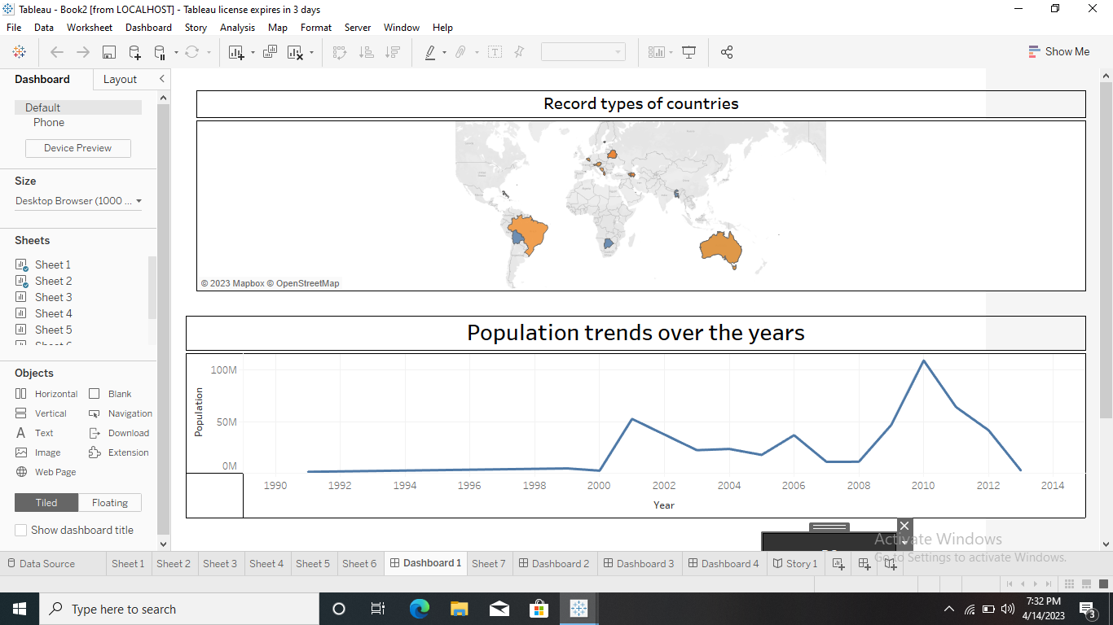
Dashboard 1

Slide 24
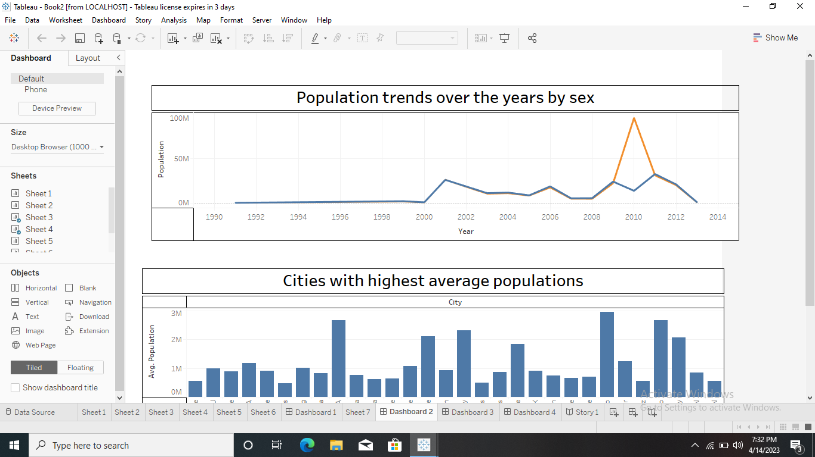
Dashboard 2

Slide 25
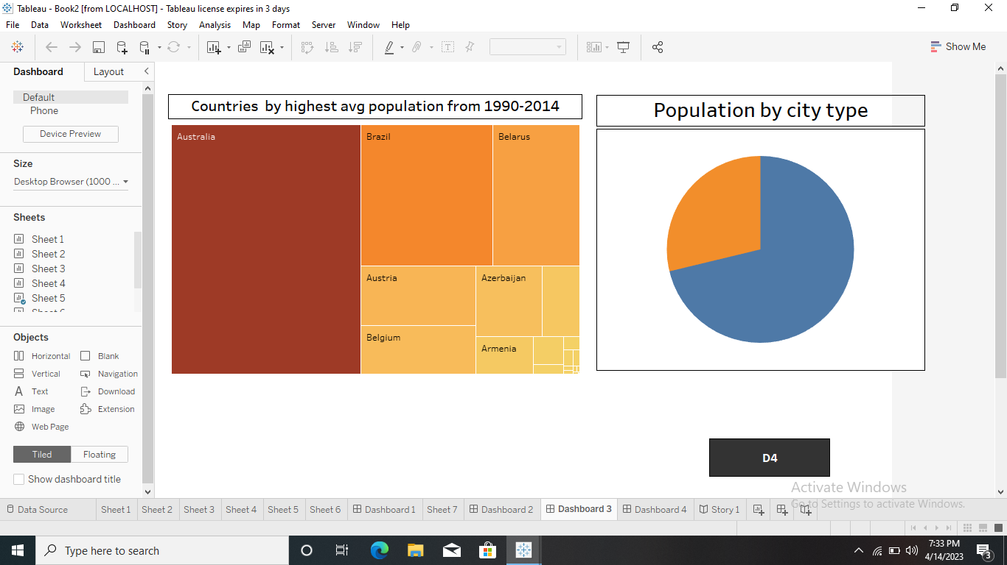
Dashboard 3

Slide 26
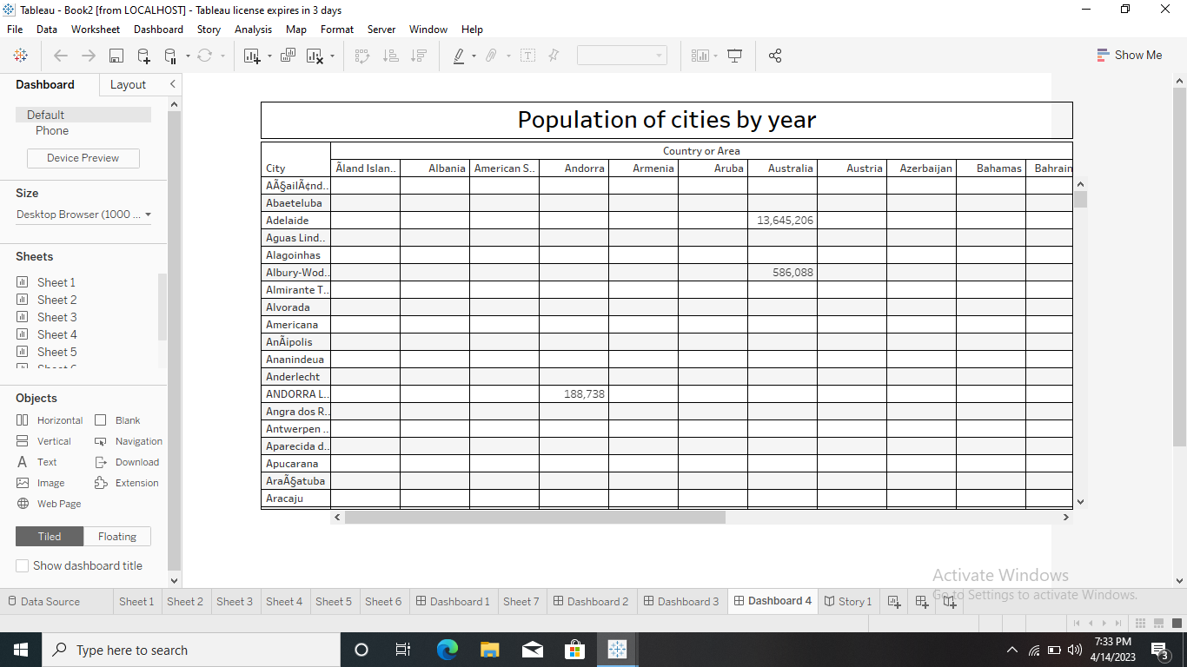
Dashboard 4

Slide 27
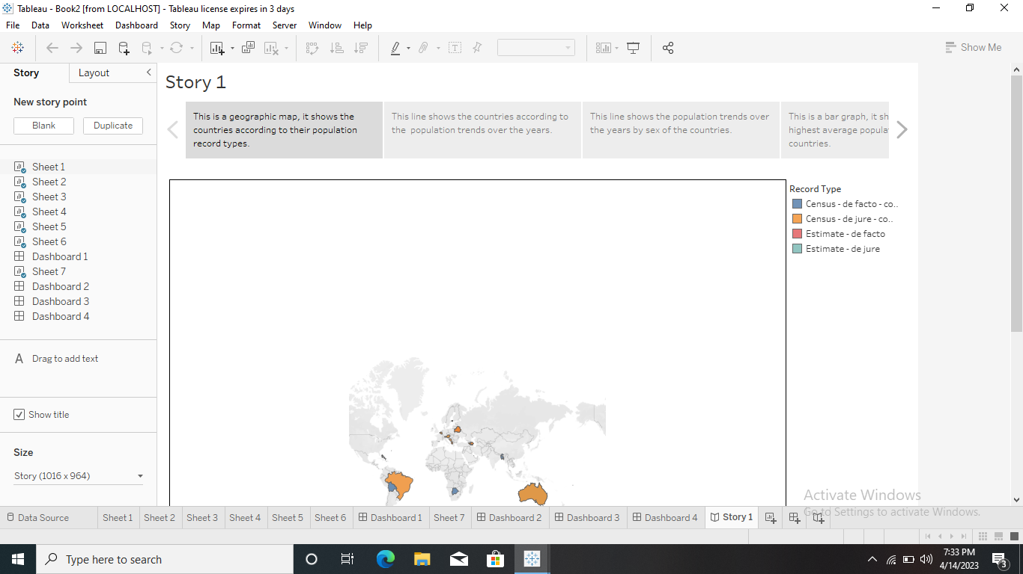
Story

Slide 28
<!DOCTYPE html>
<html dir="ltr" lang="en">
<head>
<meta charset="utf-8">
<meta http-equiv="X-UA-Compatible" content="IE=edge">
<!-- Tell the browser to be responsive to screen width -->
<meta name="viewport" content="width=device-width, initial-scale=1">
<meta name="keywords"
content="wrappixel, admin dashboard, html css dashboard, web dashboard, bootstrap 5 admin, bootstrap 5, css3 dashboard, bootstrap 5 dashboard, Ample lite admin bootstrap 5 dashboard, frontend, responsive bootstrap 5 admin template, Ample admin lite dashboard bootstrap 5 dashboard template">
<meta name="description"

Slide 29
content="Ample Admin Lite is powerful and clean admin dashboard template, inpired from Bootstrap Framework">
<meta name="robots" content="noindex,nofollow">
<title>Global Population Timeseries Analysis</title>
<link rel="canonical" href="https://www.wrappixel.com/templates/ample-admin-lite/" />
<!-- Favicon icon -->
<link rel="icon" type="image/png" sizes="16x16" href="plugins/images/favicon.png">
<!-- Custom CSS -->
<link href="plugins/bower_components/chartist/dist/chartist.min.css" rel="stylesheet">
<link rel="stylesheet" href="plugins/bower_components/chartist-plugin-tooltips/dist/chartist-plugin-tooltip.css">
<!-- Custom CSS -->
<link href="css/style.min.css" rel="stylesheet">
</head>
<body>
<!-- ============================================================== -->
<!-- Preloader - style you can find in spinners.css -->
<!-- ============================================================== -->
<div class="preloader">
<div class="lds-ripple">

Slide 30
<div class="lds-pos"></div>
</div>
</div>
<!-- ============================================================== -->
<!-- Main wrapper - style you can find in pages.scss -->
<!-- ============================================================== -->
<div id="main-wrapper" data-layout="vertical" data-navbarbg="skin5" data-sidebartype="full"
data-sidebar-position="absolute" data-header-position="absolute" data-boxed-layout="full">
<!-- ============================================================== -->
<!-- Topbar header - style you can find in pages.scss -->
<!-- ============================================================== -->
<header class="topbar" data-navbarbg="skin5">
<nav class="navbar top-navbar navbar-expand-md navbar-dark">
<div class="navbar-header" data-logobg="skin6">
<!-- ============================================================== -->
<!-- Logo -->
<!-- ============================================================== -->
<a class="navbar-brand" href="dashboard.html">
<!-- Logo icon -->
<b class="logo-icon">
<!-- Dark Logo icon -->
<img src="plugins/images/logo-icon3.jpg" alt="homepage" />
</b>
<!--End Logo icon -->
<!-- Logo text -->
<span class="logo-text">
<!-- dark Logo text -->
<img src="plugins/images/logo-text5.png" alt="homepage" />
</span>

Slide 31
</a>
<!-- ============================================================== -->
<!-- End Logo -->
<!-- ============================================================== -->
<!-- ============================================================== -->
<!-- toggle and nav items -->
<!-- ============================================================== -->
<a class="nav-toggler waves-effect waves-light text-dark d-block d-md-none"
href="javascript:void(0)"><i class="ti-menu ti-close"></i></a>
</div>
<!-- ============================================================== -->
<!-- End Logo -->
<!-- ============================================================== -->
<div class="navbar-collapse collapse" id="navbarSupportedContent" data-navbarbg="skin5">
<!-- ============================================================== -->
<!-- Right side toggle and nav items -->
<!-- ============================================================== -->
<ul class="navbar-nav ms-auto d-flex align-items-center">

Slide 32
<!-- ============================================================== -->
<!-- Search -->
<!-- ============================================================== -->
<li class=" in">
<form role="search" class="app-search d-none d-md-block me-3">
<input type="text" placeholder="Search..." class="form-control mt-0">
<a href="" class="active">
<i class="fa fa-search"></i>
</a>
</form>
</li>
<!-- ============================================================== -->
<!-- User profile and search -->
<!-- ============================================================== -->
<li>
<a class="profile-pic" href="#">
<img src="plugins/images/users/smartinternz_thumb.png" alt="user-img" width="36"
class="img-circle"><span class="text-white font-medium">Anwar</span></a>
</li>
<!-- ============================================================== -->
<!-- User profile and search -->
<!-- ============================================================== -->
</ul>
</div>
</nav>
</header>
<!-- ============================================================== -->
<!-- End Topbar header -->
<!-- ============================================================== -->
<!-- ============================================================== -->
<!-- Left Sidebar - style you can find in sidebar.scss -->
<!-- ============================================================== -->
<aside class="left-sidebar" data-sidebarbg="skin6">
<!-- Sidebar scroll-->
<div class="scroll-sidebar">
<!-- Sidebar navigation-->
<nav class="sidebar-nav">
<ul id="sidebarnav">
<!-- User Profile-->
<li class="sidebar-item pt-2">
<a class="sidebar-link waves-effect waves-dark sidebar-link" href="dashboard.html"
aria-expanded="false">
<i class="far fa-clock" aria-hidden="true"></i>
<span class="hide-menu">Visualizations</span>
</a>
</li>
<li class="sidebar-item">
<a class="sidebar-link waves-effect waves-dark sidebar-link" href="profile.html"
aria-expanded="false">
<i class="fa fa-user" aria-hidden="true"></i>
<span class="hide-menu">Profile</span>
</a>
</li>
<li class="sidebar-item">
<a class="sidebar-link waves-effect waves-dark sidebar-link" href="story.html"
aria-expanded="false">
<i class="fa fa-table" aria-hidden="true"></i>
<span class="hide-menu">Story</span>
</a>
</li>
<li class="sidebar-item">
<a class="sidebar-link waves-effect waves-dark sidebar-link" href="dash1.html"
aria-expanded="false">
<i class="fa fa-table" aria-hidden="true"></i>
<span class="hide-menu">Dashboard</span>
</a>
</li>
<!-- <li class="text-center p-20 upgrade-btn">
<a href="https://www.wrappixel.com/templates/ampleadmin/"
class="btn d-grid btn-danger text-white" target="_blank">
Upgrade to Pro</a>
</li> -->
</ul>
</nav>
<!-- End Sidebar navigation -->
</div>
<!-- End Sidebar scroll-->
</aside>
<!-- ============================================================== -->
<!-- End Left Sidebar - style you can find in sidebar.scss -->
<!-- ============================================================== -->
<!-- ============================================================== -->
<!-- Page wrapper -->
<!-- ============================================================== -->
<div class="page-wrapper">
<!-- ============================================================== -->
<!-- Bread crumb and right sidebar toggle -->
<!-- ============================================================== -->
<div class="page-breadcrumb bg-white">
<div class="row align-items-center">
<div class="c

Slide 33
</ul>
</nav>
<!-- End Sidebar navigation -->
</div>
<!-- End Sidebar scroll-->
</aside>
<!-- ============================================================== -->
<!-- End Left Sidebar - style you can find in sidebar.scss -->
<!-- ============================================================== -->
<!-- ============================================================== -->
<!-- Page wrapper -->
<!-- ============================================================== -->
<div class="page-wrapper">
<!-- ============================================================== -->
<!-- Bread crumb and right sidebar toggle -->
<!-- ============================================================== -->
<div class="page-breadcrumb bg-white">
<div class="row align-items-center">
<div class="c

Slide 34
<h4 class="page-title">Dashboard</h4>
</div>
<div class="col-lg-9 col-sm-8 col-md-8 col-xs-12">
<div class="d-md-flex">
<ol class="breadcrumb ms-auto">
<li><a href="#" class="fw-normal">Dashboard</a></li>
</ol>
<a href="https://www.un.org/development/desa/pd/" target="_blank"
class="btn btn-danger d-none d-md-block pull-right ms-3 hidden-xs hidden-sm waves-effect waves-light text-white">UN
Website</a>
</div>
</div>
</div>
<!-- /.col-lg-12 -->
</div>
<!-- ============================================================== -->
<!-- End Bread crumb and right sidebar toggle -->
<!-- ============================================================== -->
<!-- ============================================================== -->
<!-- Container fluid -->
<!-- ============================================================== -->
<div class="container-fluid">
<!-- ============================================================== -->
<!-- Three charts -->
<!-- ==================================================

Slide 35
<!-- ============================================================== -->
<!-- PRODUCTS YEARLY SALES -->
<!-- ============================================================== -->
<div class='tableauPlaceholder' id='viz1674235317004' style='position: relative'>
<noscript><a href='#'><img alt='Population record types of countries ' src='https:&#47;&#47;public.tableau.com&#47;static&#47;images&#47;po&#47;population_viz1&#47;Sheet1&#47;1_rss.png' style='border: none' /></a>
</noscript>
<object class='tableauViz' style='display:none;'>
<param name='host_url' value='https%3A%2F%2Fpublic.tableau.com%2F' />
<param name='embed_code_version' value='3' />
<param name='site_root' value='' />
<param name='name' value='population_viz1&#47;Sheet1' />
<param name='tabs' value='no' />
<param name='toolbar' value='yes' />
<param name='static_image' value='https:&#47;&#47;public.tableau.com&#47;static&#47;images&#47;po&#47;population_viz1&#47;Sheet1&#47;1.png' />
<param name='animate_transition' value='yes' />
<param name='display_static_image' value='yes' />
<param name='display_spinner' value='yes' />
<param name='display_overlay' value='yes' />
<param name='display_count' value='yes' />
<param name='language' value='en-US' />
<param name='filter' value='publish=yes' />
</object></div>
<script type='text/javascript'>
var divElement = document.getElem

Slide 36
var vizElement = divElement.getElementsByTagName('object')[0];
vizElement.style.width='100%';vizElement.style.height=(divElement.offsetWidth*0.75)+'px'; var scriptElement = document.createElement('script'); scriptElement.src = 'https://public.tableau.com/javascripts/api/viz_v1.js';
vizElement.parentNode.insertBefore(scriptElement, vizElement);
</script>
<!-- ============================================================== -->
<!-- RECENT SALES -->
<!-- ============================================================== -->
<!-- <h3 class="box-title mb-0">Trend</h3> -->
<div class='tableauPlaceholder' id='viz1674235531254' style='position: relative'><noscript>
<a href='#'><img alt='Population trends over the years ' src='https:&#47;&#47;public.tableau.com&#47;static&#47;images&#47;po&#47;population_viz2&#47;Sheet2&#47;1_rss.png' style='border: none' /></a></noscript><object class='tableauViz' style='display:none;'>
<param name='host_url' value='https%3A%2F%2Fpublic.tableau.com%2F' />
<param name='embed_code_version' value='3' />
<param name='site_root' value='' />
<param name='name' value='population_viz2&#47;Sheet2' />
<param name='tabs' value='no' /><param name='toolbar' value='yes' />
<param name='static_image' value='https:&#47;&#47;public.tableau.com&#47;static&#47;images&#47;po&#47;population_viz2&#47;Sheet2&#47;1.png' /> <param name='animate_transition' value='yes' />
<param name='display_static_image' value='yes' />
<param name='display_spinner' value='yes' />
<param name='display_overlay' value='yes' />
<param name='display_count' value='yes' />
<param name='language' value='en-US' />
<param name='filter' value='publish=yes' />
</object></div>
<script type='te

Slide 37
var divElement = document.getElementById('viz1674235531254');
var vizElement = divElement.getElementsByTagName('object')[0];
vizElement.style.width='100%';vizElement.style.height=(divElement.offsetWidth*0.75)+'px';
var scriptElement = document.createElement('script');
scriptElement.src = 'https://public.tableau.com/javascripts/api/viz_v1.js';
vizElement.parentNode.insertBefore(scriptElement, vizElement);
</script>
<!-- ============================================================== -->
<!-- Recent Comments -->
<!-- ============================================================== -->
<!-- ============================================================== -->
<!-- End Container fluid -->
<!-- ============================================================== -->
<!-- ============================================================== -->
<!-- footer -->
<!-- ============================================================== -->
<footer class="footer text-center"> 2022 © Smartinternz brought to you by <a
href="https://www.thesmartbridge.com/">thesmartbridge.com</a>
</footer>
<!-- ============================================================== -->
<!-- End footer -->
<!-- ============================================================== -->
</div>
<!-- ============================================================== -->
<!-- End Page wrapper -->
<!-- ============================================================== -->
</div>
<!-- ============================================================== -->
<!-- End Wrapper -->
<!-- ============================================================== -->
<!-- ============================================================== -->
<!-- All Jquery -->
<!-- ============================================================== -->
<script src="plugins/bower_components/jquery/dist/jquery.min.js"></script>
<!-- Bootstrap tether Core JavaScript -->
<script src="bootstrap/dist/js/bootstrap.bundle.min.js"></script>
<script src="js/app-style-switcher.js"></script>
<script src="plugins/bower_components/jquery-sparkline/jquery.sparkline.min.js"></script>
<!--Wave Effects -->
<script src="js/waves.js"></script>
<!--Menu sidebar -->
<script src="js/sidebarmenu.js"></script>
<!--Custom JavaScript -->
<script src="js/custom.js"></script>
<!--This page JavaScript -->
<!--chartis chart-->
<script src="plugins/bower_components/chartist/dist/chartist.min.js"></script>
<script src="plugins/bower_components

Slide 38
<script src="js/pages/dashboards/dashboard1.js"></script>
</body>
</html>

Slide 39
THANKYOU

